Slide 1


UAV Beam Tracking
Seongjoon, kang

Slide 2
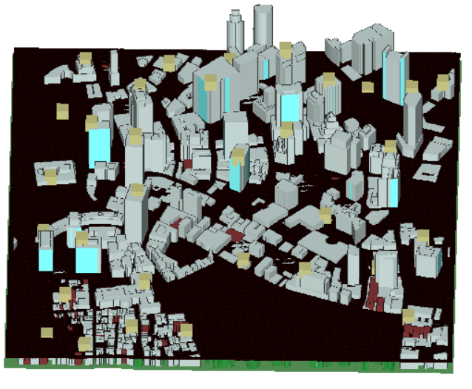
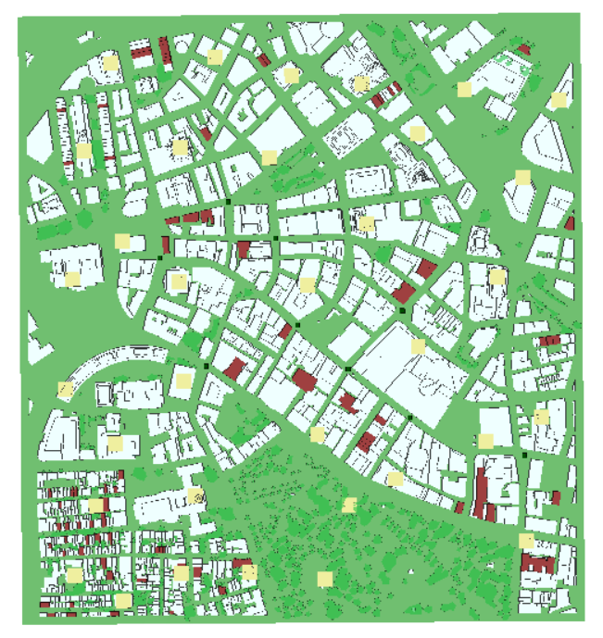
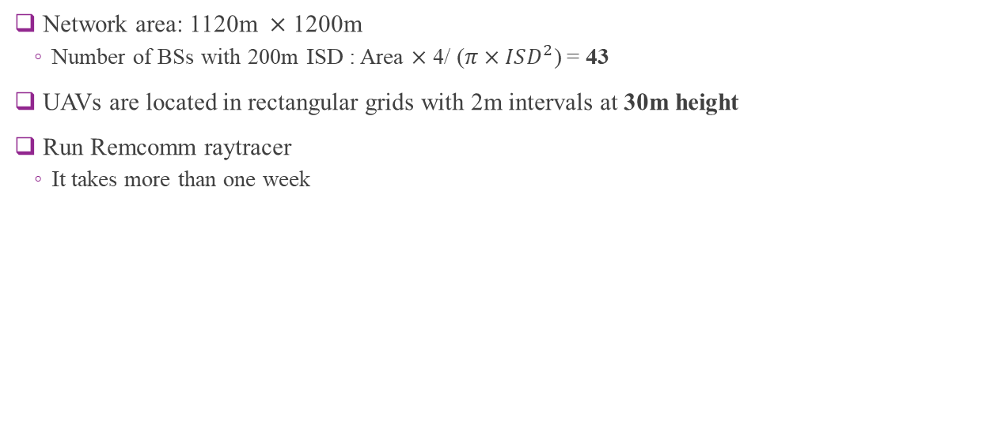
Data Generation
Network area: 1120m $×$ 1200m
Number of BSs with 200m ISD : Area $×$ 4/ ($π×ISD^{2}$) = 43
UAVs are located in rectangular grids with 2m intervals at 30m height
Run Remcomm raytracer
It takes more than one week
Deployment of UAVs
Deployment of BSs

Slide 3
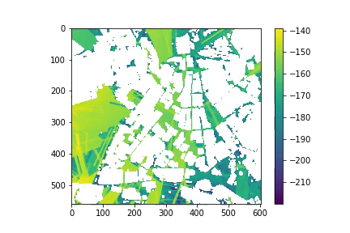
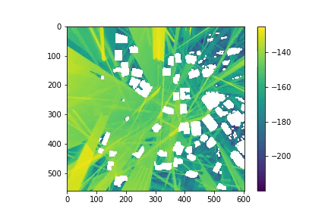
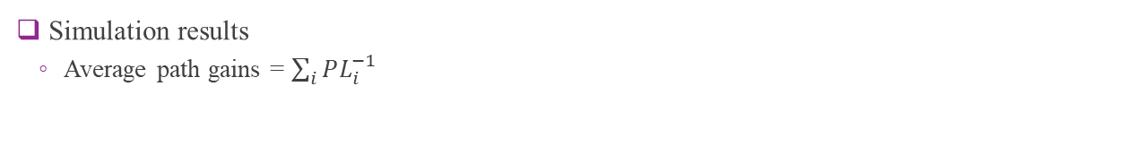
Data Generation
Simulation results
Average path gains = $\sum_{i}{PL_{i}^{−1}}$
30m height
60m height

Slide 4
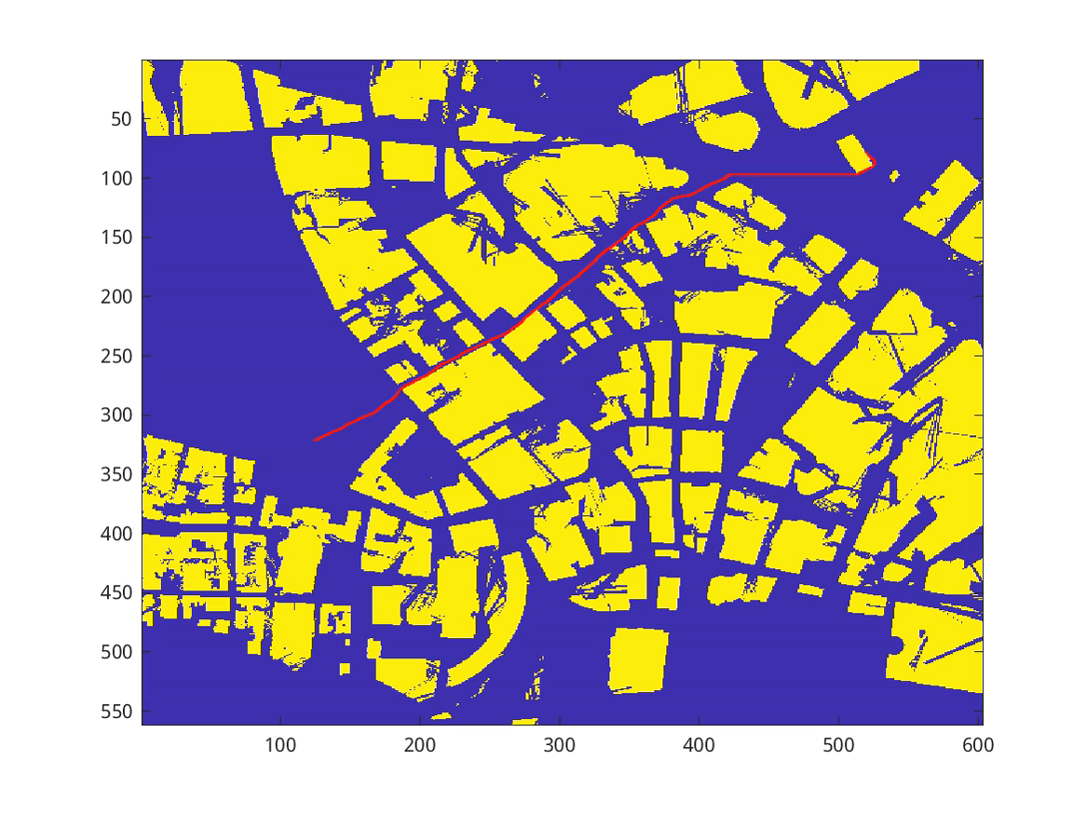

Data Generation
Generate random trajectories based on bit-map
Generate vector-quantization codebook (VQ codebook) with MIMO setting
30m height
30m height

Slide 5
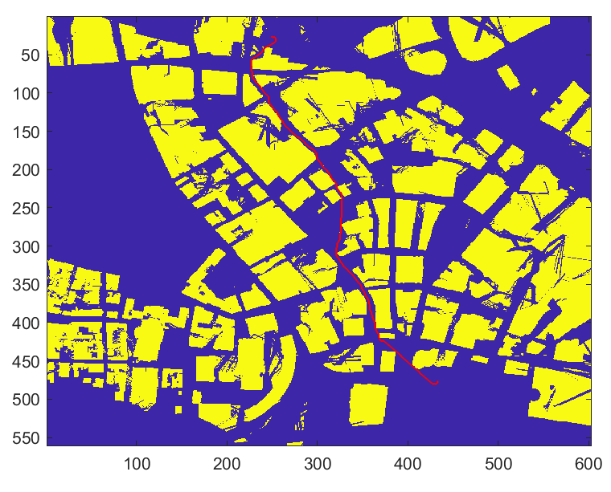
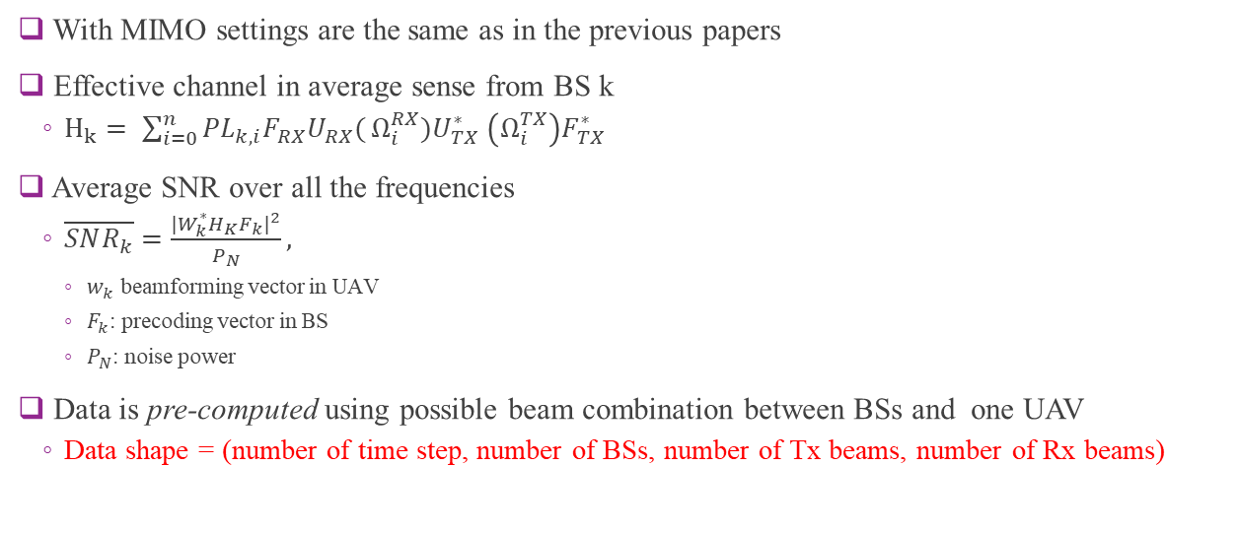
Data Generation
With MIMO settings are the same as in the previous papers
Effective channel in average sense from BS k
$H_{k}= \sum_{i=0}^{n}{{PL}_{k,i}F_{RX}U_{RX}(}Ω_{i}^{RX})U_{TX}^{∗} \left(Ω_{i}^{TX}\right)F_{TX}^{∗}$
Average SNR over all the frequencies
$\overline{SNR_{k}}=\frac{{|W}_{k}^{∗}H_{K}F_{k}{\left.​\right|}^{2}}{P_{N}},$
$w_{k}$ beamforming vector in UAV
$F_{k}$: precoding vector in BS
$P_{N}$: noise power
Data is pre-computed using possible beam combination between BSs and one UAV
Data shape = (number of time step, number of BSs, number of Tx beams, number of Rx beams)
data shape = (720, 43, 64, 16)

Slide 6
Scenario Under Consideration
Preliminary Assumption:
UAV periodically senses the signal from all the BSs and chooses the best BS
UAV can estimate the channel statistics and find the optimal beamforming vector
BS doesn’t know the optimal index of its codebook to perform beamforming to UAV
UAV knows
the best BS
optimal codebook index
BS doesn’t know
the optimal beam index toward the UAV

Slide 7
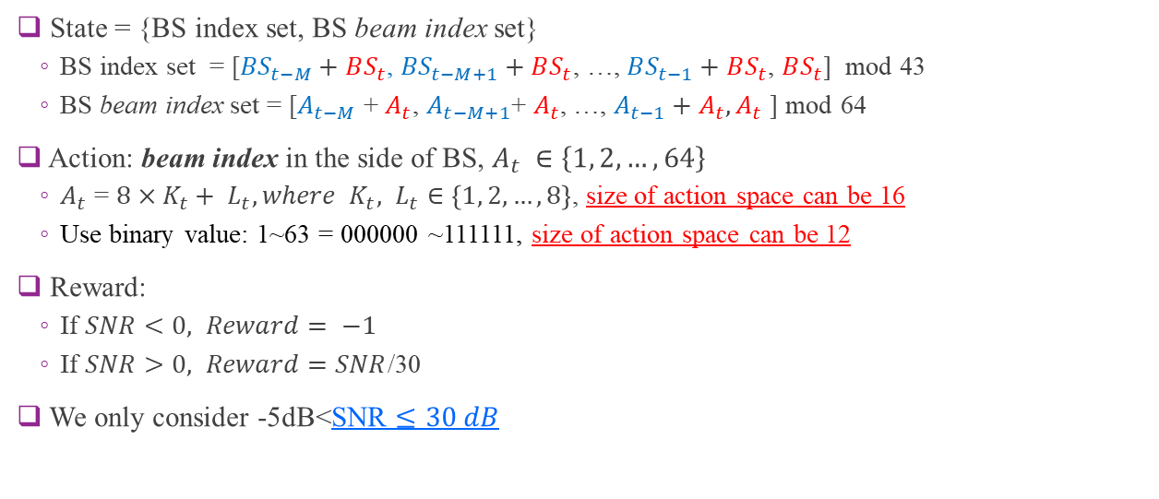
Deep Q-Learning
State = {BS index set, BS beam index set}
BS index set = [${BS}_{t−M}+BS_{t}$, ${BS}_{t−M+1}+BS_{t}$, …, $BS_{t−1}+BS_{t}$, $BS_{t}$] mod 43
BS beam index set = [$A_{t−M}$ + $A_{t}$, $A_{t−M+1}\text{+ }A_{t}$, …, $A_{t−1}+A_{t},A_{t}$ ] mod 64
Action: beam index in the side of BS, $A_{t} ∈\left\{1, 2, …, 64\right\}$
$A_{t}$ = $8×K_{t}+ L_{t}, where {K_{t}, L}_{t}∈\left\{1, 2, …, 8\right\}$, size of action space can be 16
Use binary value: 1~63 = 000000 ~111111, size of action space can be 12
Reward:
If $SNR<0, Reward= −1$
If $SNR>0, Reward=SNR$/30
We only consider -5dB<SNR $≤30 dB$

Slide 8
Deep Q-Learning
Two different DQN algorithms
Double DQN : using two different neural networks as online and target Queue tables
TD3 : Twin delayed deep deterministic policy gradient algorithm
Built-in library
https://docs.ray.io/en/master/rllib/rllib-training.html

Slide 9
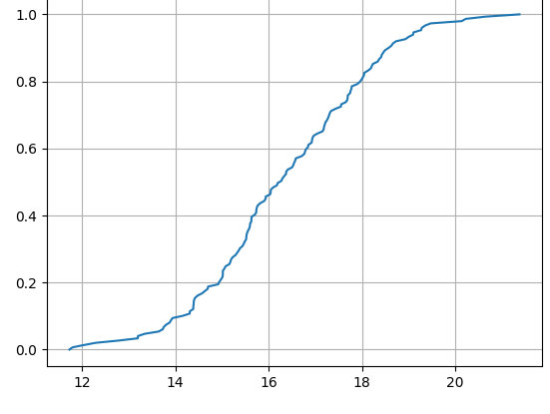
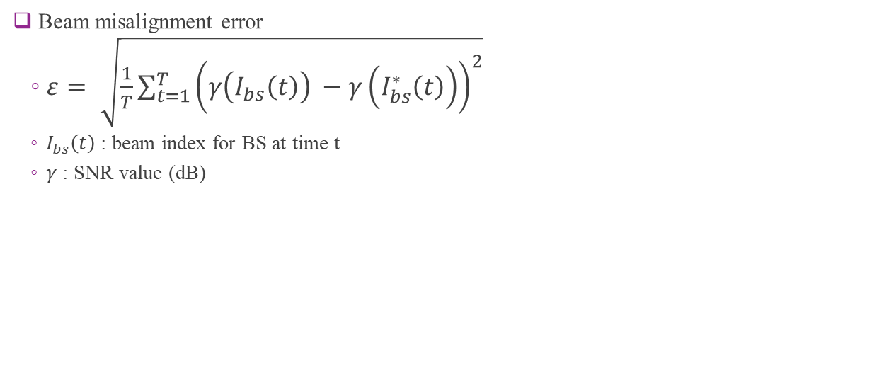
Preliminary Results
Beam misalignment error
$ε= \sqrt{\frac{1}{T}\sum_{t=1}^{T}{{\left(γ\left(I_{bs}\left(t\right)\right) −γ\left(I_{bs}^{∗}\left(t\right)\right)\right)}^{2}}}$
$I_{bs}\left(t\right)$ : beam index for BS at time t
$γ$ : SNR value (dB)
CDF
Beam misalignment error (dB)

Slide 10
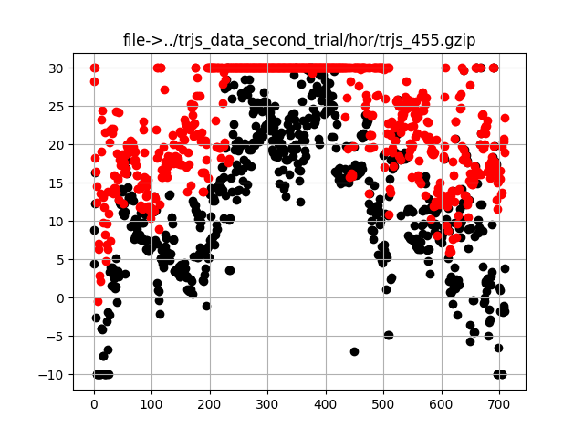
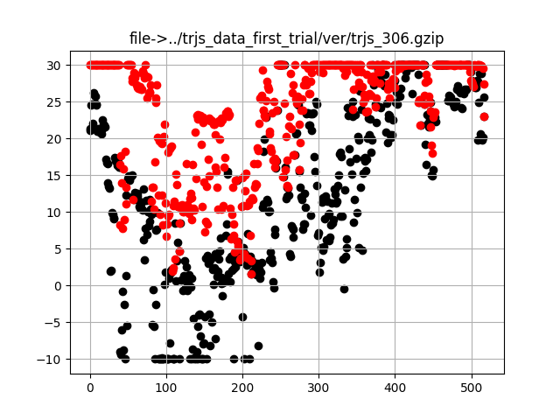
Examples of Episodes
SNR (dB)
SNR (dB)
Time steps (s)
Time steps (s)

Slide 11
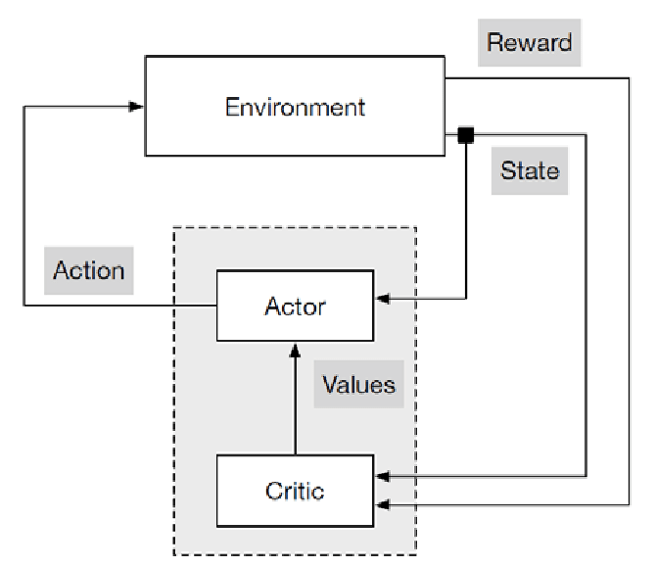
Actor-Critic Methods
Actor receives state and determines action
Critic receives state and action and output values

Slide 12
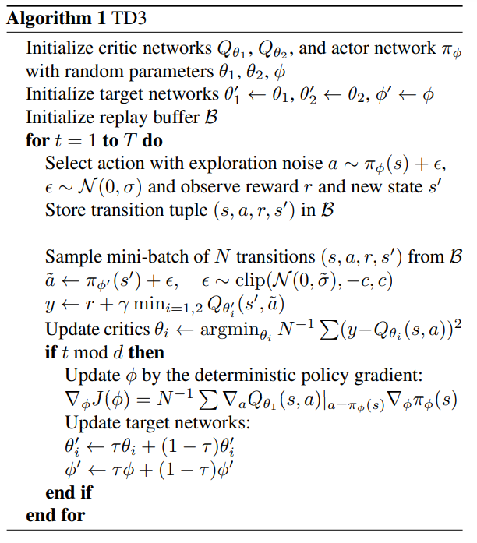
TD3 Q Learning Algorithm
Employ two critic Q-networks and one actor-network
Delay update for actor-network
Target Policy Smoothing Regularization
Similar actions should have similar values

Slide 13
Double Q Learning

Slide 15
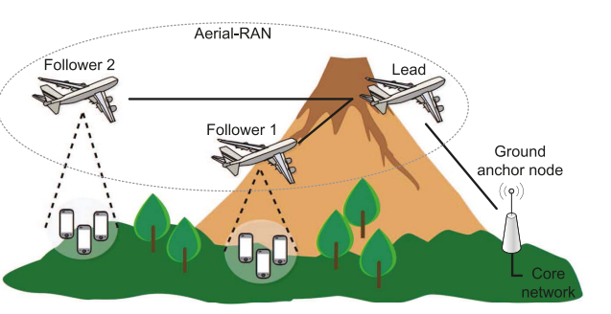
State of Art
Chiang, Hsiao-Lan, et al. "Machine-learning beam tracking and weight optimization for mmwave multi-UAV links."
Q-learning based beam tracking scheme using current/past observations

